Slide 1


NOVORA 2K26
TEAM NAME: WHITE TIGERS

Slide 2
INVENTRA
A PRODUCT INVENTORY SYSTEM

Slide 3
OUR TEAM
KASI SAI DHANUSH
KASI SAI AKASH
ROSHAN CHILUKA
MODALLA PRANITH REDDY

Slide 4
BACKGROUND
Inventory management is a vital component of every business. Many small businesses use notebooks and/or spreadsheets to manage their inventory. This may cause errors in inventory management and stock mismanagement.
A digital inventory system helps businesses manage their products and inventory efficiently.

Slide 5
INTRODUCTION
Inventra is a full stack web application that helps businesses manage and track their product inventory.
The system enables users to:
View all the products available
Update the quantity of products
Identify products with low stock levels
The web application combines the best of the frontend, backend, and database technologies to offer efficient inventory management.

Slide 6
PROBLEMS
There are many challenges which many organizations face in the management of their inventory.
Some of these challenges are as follows:
Manual inventory control may cause errors.
Difficulty in controlling inventory levels.
There is a lack of centralized information on products.
It is difficult to identify the products that are in low stock.
These challenges explain the importance and need for an automated inventory control system.

Slide 7
GOALS
The main objectives of the Inventra system are as follows:
To develop a full-stack inventory management system.
To store product information in a database.
To enable users to easily add or update product stock.
To identify products with low stock automatically.
To provide a simple and efficient user interface.

Slide 8
METHODOLOGY
The system is developed using a three-tier architecture.
Frontend
HTML
CSS
JavaScript
Backend
Developed using Node.js and Express
Handles API requests and business logic
Database
MongoDB is used to store product data.
System Flow
User → Frontend → Backend API → MongoDB Database

Slide 9
RESULT
The Inventra system effectively completes the following tasks:
Include new items in the stock.
Show every product within the system.
Revise the product quantities.
Determine which items have low stock.

Slide 10
CONCLUSION
Inventra helps to efficiently manage the product inventory.
This application makes the storage of product information and the updating of the product inventory easy.
This project has shown the use of full stack development technologies and REST API to create a web application.

Slide 11
RECOMMENDATION
Some possible enhancements that may be included in the system in the future are as follows:
Product Search Functionality
Sort Products Based on Price and Quantity
Inventory Analytics and Reports
User Authentication for Admin Access
Deploying the System on Cloud Platforms
These enhancements may help the system become more powerful and applicable in the real world.

Slide 12
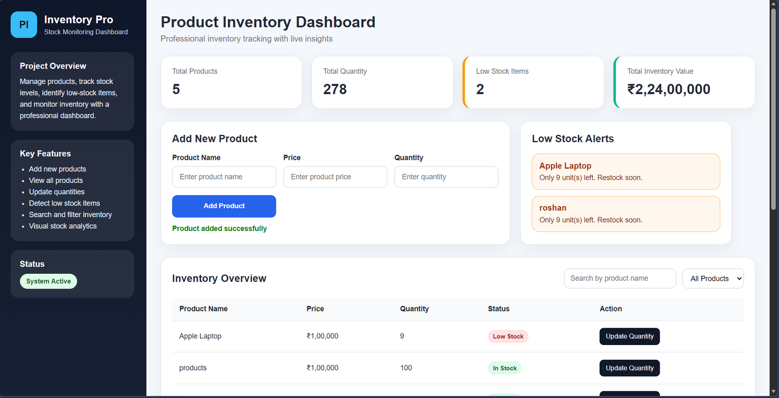

Slide 13
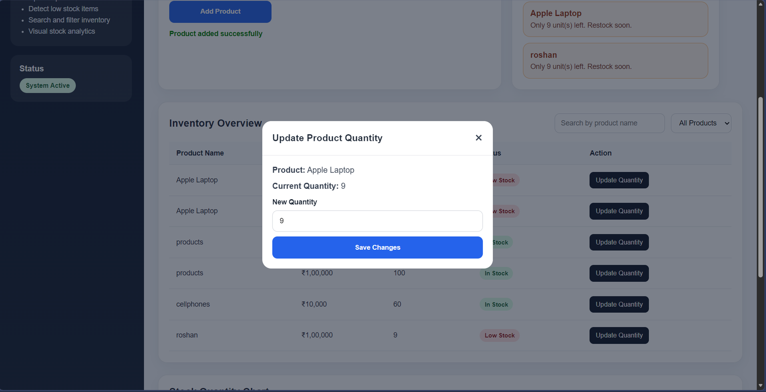

Slide 14
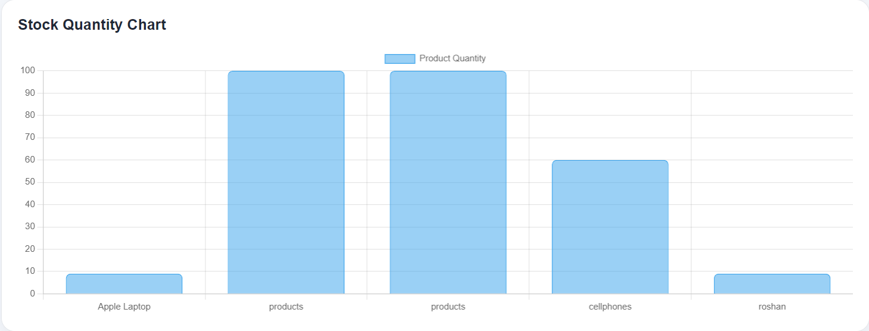

Slide 15
THANK
You

